Slide 1

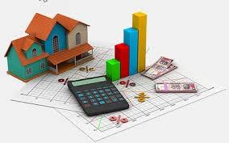
House Price Prediction

Slide 2

Introduction
Why House Price prediction model is necessary?
Normal buyers face many issues while buying houses as they are not aware of prices
Factors that might affect the prices is not easy to guess
Cost of taking advice from mediators like agents
Your agent might hide something from you

Slide 3
Problem Statement
Predict price of house based of given factors:
79 available parameters(Explanatory)
Predict SalePrice(Target) with least difference from actual
Provide information with the predicted results

Slide 4
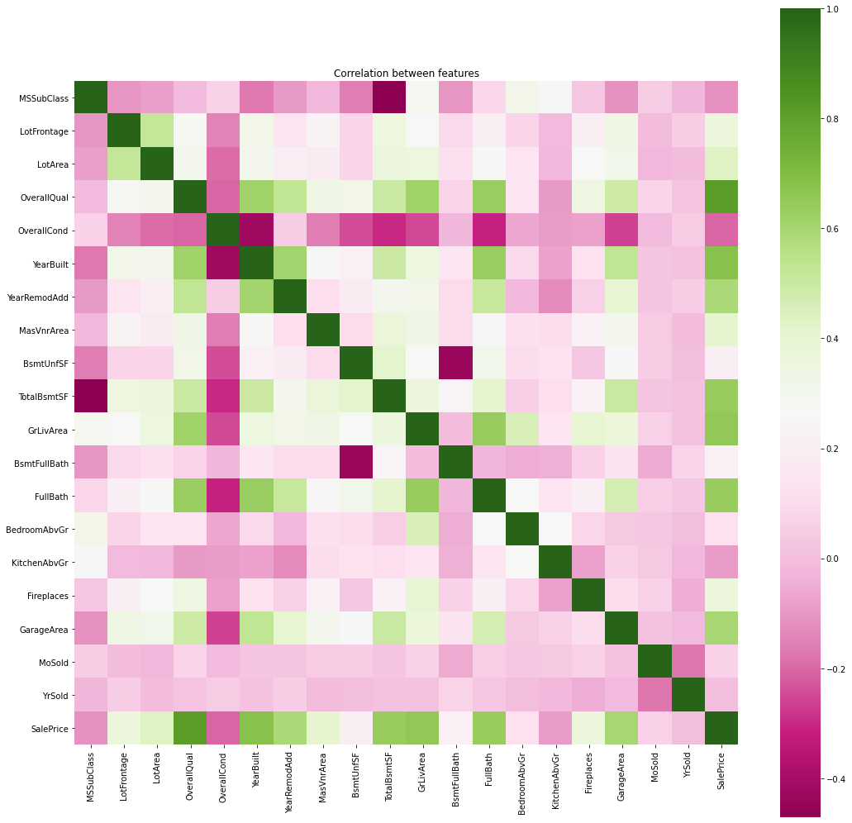
Correlation Matrix
None of the feature is highly affecting sale price alone

Slide 5
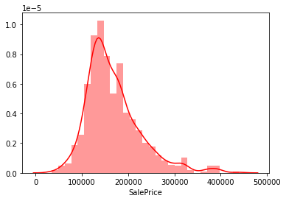
House Sale Prices
Most houses in 100k-350k range
Features like overall quality, pool area, garage area, living area highly affecting prices

Slide 6
ML Models used
Linear Regression
Random Forest
Decision Tree

Slide 7
Models Evaluation Result
Model | R Squared Train Set | R Squared Test Set | RMSE Train Set | RMSE Test Set
Linear Regression | 0.9159 | 0.8957 | 0.0961 | 0.1131
Random Forest | 0.9785 | 0.8081 | 0.0486 | 0.1535
Decision Tree | 0.9999 | 0.5296 | 0.00003 | 0.2403

Slide 8
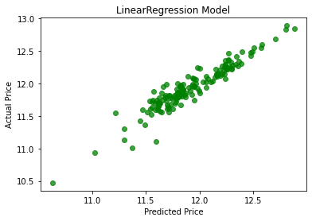
Predicted vs Actual Price
Predicted and Actual prices are very close with very less difference

Slide 9
Conclusion
Linear Regression model performed better and predicted best results
Difference in R squared values for training and test set is very small

